Slide 1
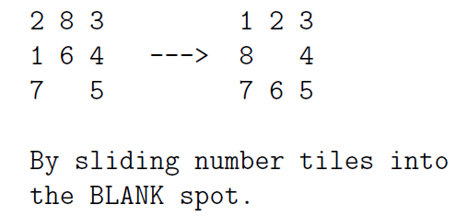
GraphSearch Application: 8-puzzle (states, successors, search)

Slide 2
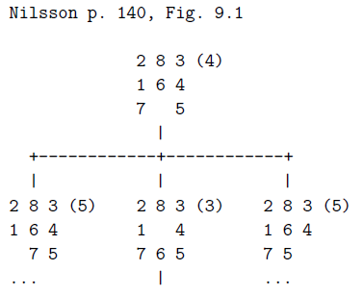

Slide 3
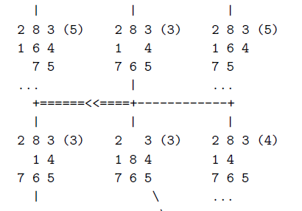

Slide 4
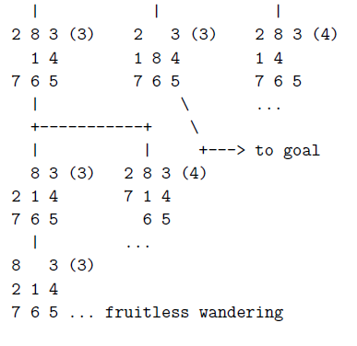

Slide 5
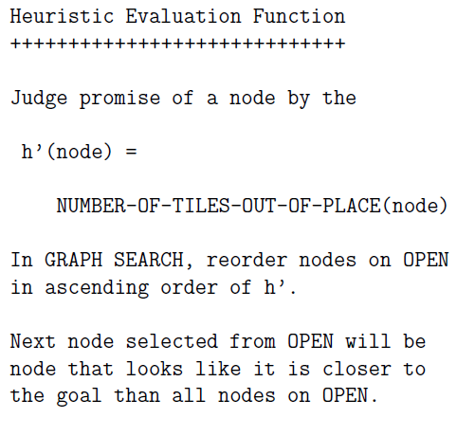
What are the (numbers)? ….

Slide 6
Notice:
The heuristic evaluation function has NOT been helpful
☹

Slide 7
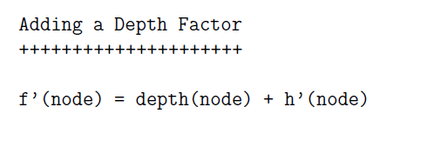


Slide 8
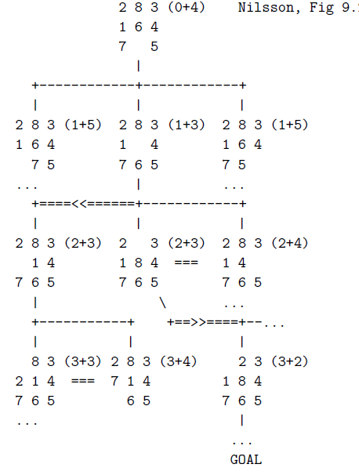

Slide 9
What just happened?
… State in your own words how the addition of a depth factor to an eval function value lead to better guidance towards a solution.

Slide 10
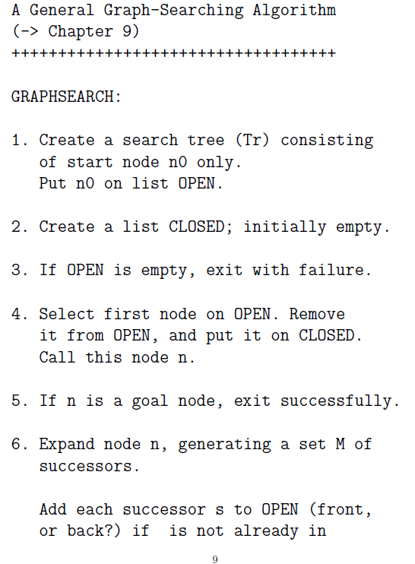

Slide 11
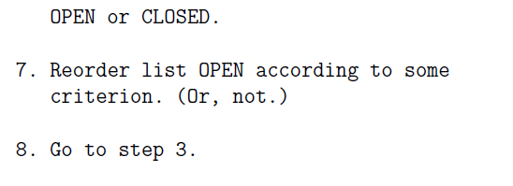

Slide 12
A* Variant of GraphSearch
...of greatest interest to AI
In order to effectively prevent search to enter cycles, steps 6. and 7. should be refined further as elaborated by Nilsson in Chapt 9.2, pp. 145.
Implementations of these measure can get quite involved; several options exist. (Defer to lab …)

